Slide 1


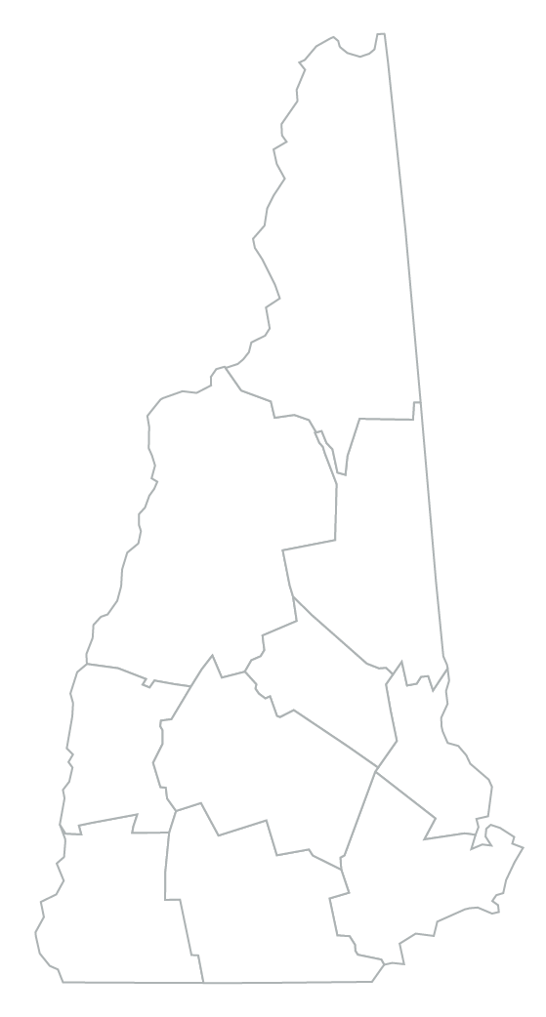









School Data Profile
Name of School
Student Well-Being
ABC School || School District
School Snapshot
ABC School || School District
Ethnicity & Race
of students
receiving mental
health services
### || ###
students per counselor
## || ##
nurse visits
(per 100 students)
American Indian or Alaskan | N/A | N
Asian or Pacific Islander | <10% | <10%
Black or African American | N | <10%
Hispanic or Latino | <10% | <10%
White | 85.1% | 88.6%
Multiple Races | <10% | <10%
N = Data suppressed due to student population being <11; N/A = Data not applicable
## || ##
students habitually truant (per 100 students)
Discipline & Safety
ABC School || School District
##### || ######
student enrollment
## || ##
## || ##
XX% || XX%
students with disabilities
XX% || XX%
eligible for Free & Reduced Lunch
## || ##
average class size
restraints and seclusions
(per 100 students)
reported incidents of bullying (per 100 students)
## || ##
XX% || XX%
XX% || XX%
XX% || XX%
proficiency in English Language Arts (ELA)
XX% || XX%
proficiency in mathematics
$##### || $#####
cost per pupil
incidents of violence (per 100 students)
students receiving
out-of-school suspensions
students receiving
in-school suspensions
Notes:
*** INSTRUCTIONS: Move the star on the map to the location of your school ***

Slide 2
Indicator Name | Year | Link to Data Source
Ethnicity & Race |  | https://dashboard.nh.gov/t/DOE/views/iReport/FrontPage?:iid=1&:tabs=no&:isGuestRedirectFromVizportal=y&:embed=y
Student enrollment |  | https://dashboard.nh.gov/t/DOE/views/iReport/FrontPage?:iid=1&:tabs=no&:isGuestRedirectFromVizportal=y&:embed=y
Students with disabilities |  | https://dashboard.nh.gov/t/DOE/views/iReport/FrontPage?:iid=1&:tabs=no&:isGuestRedirectFromVizportal=y&:embed=y
Eligible for Free & Reduced Lunch |  | https://www.education.nh.gov/sites/g/files/ehbemt326/files/inline-documents/sonh/lunch-school21-22.xls
Average class size |  | https://dashboard.nh.gov/t/DOE/views/iReport/FrontPage?:iid=1&:tabs=no&:isGuestRedirectFromVizportal=y&:embed=y
Proficiency in English Language Arts (ELA) |  | https://dashboard.nh.gov/t/DOE/views/iReport/FrontPage?:iid=1&:tabs=no&:isGuestRedirectFromVizportal=y&:embed=y
Proficiency in mathematics |  | https://dashboard.nh.gov/t/DOE/views/iReport/FrontPage?:iid=1&:tabs=no&:isGuestRedirectFromVizportal=y&:embed=y
Cost per pupil |  | https://dashboard.nh.gov/t/DOE/views/iReport/FrontPage?:iid=1&:tabs=no&:isGuestRedirectFromVizportal=y&:embed=y
Students receiving mental health services |  | school records
Nurse visits (per 100 students) |  | school records
Students per counselor |  | https://dashboard.nh.gov/#/site/DOE/views/iExplore/Explore-Dashboard?:iid=2&:tabs=no
Students habitually truant (per 100 students) |  | https://www.education.nh.gov/sites/g/files/ehbemt326/files/inline-documents/sohn/safety21-22.xlsx
Restraints and seclusions |  | https://www.education.nh.gov/sites/g/files/ehbemt326/files/inline-documents/sohn/safety21-22.xlsx
Reported incidents of bullying (per 100 students) |  | https://www.education.nh.gov/sites/g/files/ehbemt326/files/inline-documents/sohn/safety21-22.xlsx
Incidents of violence (per 100 students) |  | https://dashboard.nh.gov/t/DOE/views/iReport/FrontPage?:iid=1&:tabs=no&:isGuestRedirectFromVizportal=y&:embed=y
Students receiving in-school suspensions |  | https://dashboard.nh.gov/t/DOE/views/iReport/FrontPage?:iid=1&:tabs=no&:isGuestRedirectFromVizportal=y&:embed=y
Students receiving out-of-school suspensions |  | https://dashboard.nh.gov/t/DOE/views/iReport/FrontPage?:iid=1&:tabs=no&:isGuestRedirectFromVizportal=y&:embed=y

